Slide 1
Quality and Process Data Analysis
Statistical Quality and Process Data Analysis in Cement

Slide 2
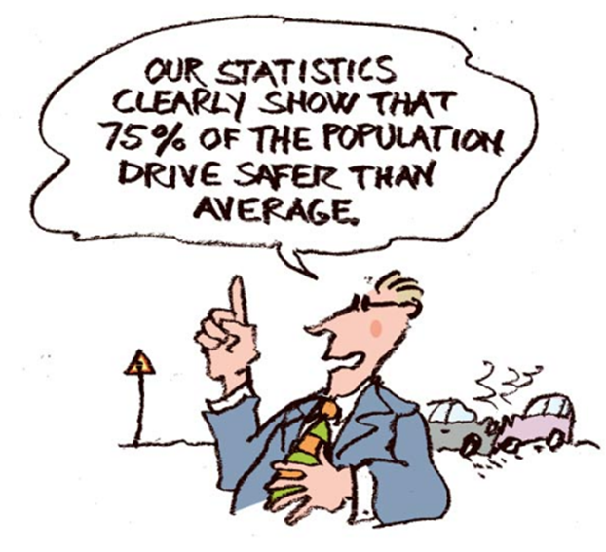
Data evaluation in practice
Notes:
Random, arbitrary, subjective

Slide 3
Objectives
Know about the different statistical methods to evaluate process and quality data
Standard or proven methods / application
Show opportunities
Be aware of limitations of statistical methods
Be encouraged to apply statistical methods on your own data

Slide 4
Agenda (Process Data Analysis)
Introduction
Quality Data Analysis
Basic Statistical Indicators
Normal distribution
Graphical Presentation and Analysis (control charts)
Statistical Tests
Treatment of outliers
Applications
Dixon test
Grubbs test

Slide 5
Descriptive statistics: Measure of location
(Arithmetic) Mean or Average)
Notes:
Mean is a measure of the central tendency of a dataset.
Sum of residuals (summed difference of all individual values to the mean) is zero
The mean is not a robust measure, it is heavily affected by outliers (extreme values)

Slide 6
Descriptive statistics: Measure of location
Median, minimum and maximum (range)
minimum
median
maximum
Range = maximum - minimum
Notes:
Median definition: The middle value of a sample set that divides the upper half from the lower half
Measure of the central tendency
More robust than average, can be applied to skewed/asymmetric datasets
Example: trace elements in AFR
Question: What happens with bimodal distributions? -> also mode can be important
Range measures the difference between the lowest and the highest sample data (simplest measure of variability)

Slide 7
What is the difference between mean and median?
Histogram of income. Chose your salary – mean or median?
Notes:
Mean and Median both measure central tendency. However, Mean is more sensitive to outliers

Slide 8
Descriptive statistics: Measure of variability
Standard deviation
Notes:
Measure of variability: Average of differences to mean
Square root to eliminate negative values
High standard deviation indicates high variation.

Slide 9
Descriptive statistics: measure of variability
Coefficient of variation
Notes:
Relates standard deviation to an absolute value (e.g. for comparison), i.e normalization
Assumes that s increases with Xbar
It is useful to compare the degree of variation between data series.
It is mainly used to calculate Cement Uniformity.

Slide 10
A useful chart: The boxplot
Outliers
Maximum
Q3 (75%)
Median (50%)
Q1 (25%)
Minimum
Notes:
Concise representation of median, min, max, and quartiles.
The larger the box, the larger the variation.

Slide 11
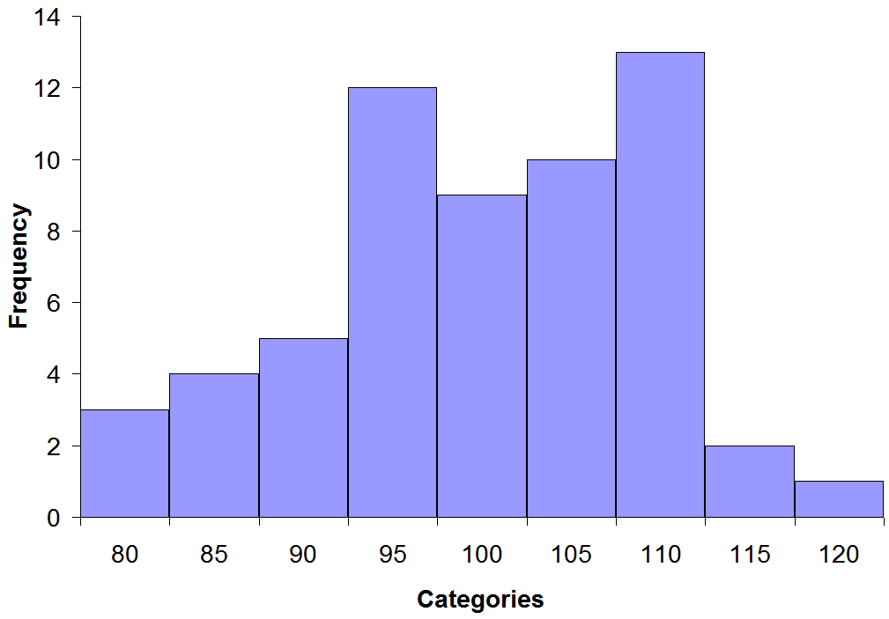
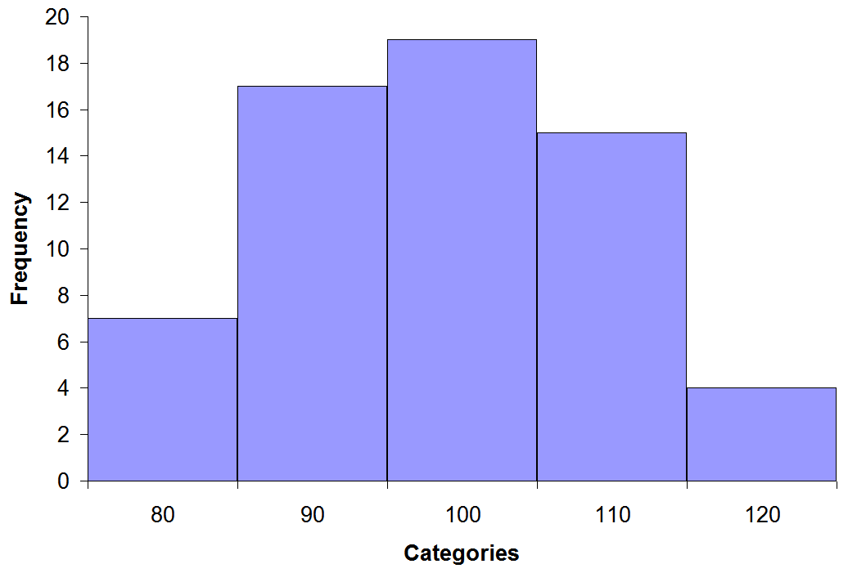
A useful chart: The histogram
Key components:
Horizontal axis: Categories - divide data range into (equally sized) bins
Vertical axis: Frequency - Number of occurrences
Number of categories k: Typically k = n^{1/2}
Same data set (60) – different number of categories
Notes:
Wrong number of categories can lead to misleading information about data sets.

Slide 12
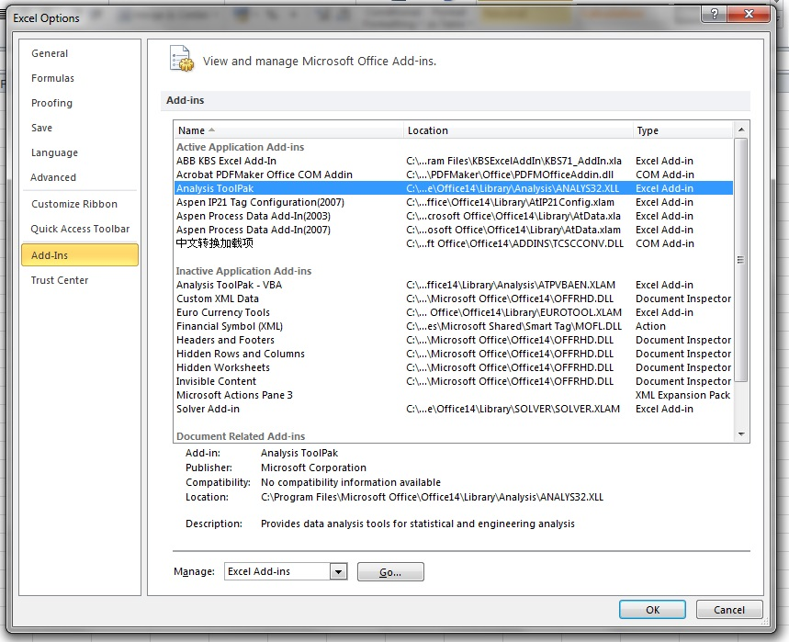
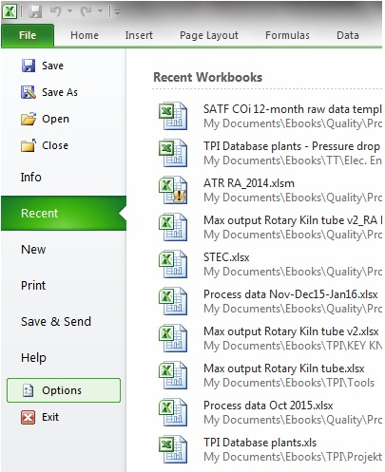
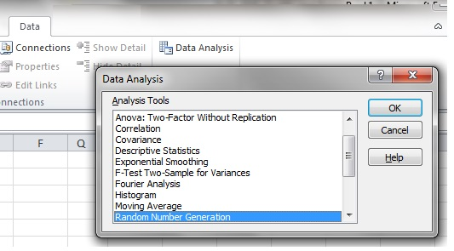
Enabling the data analysis functions in Excel (version 2010)
Enable Add-ins

Slide 13
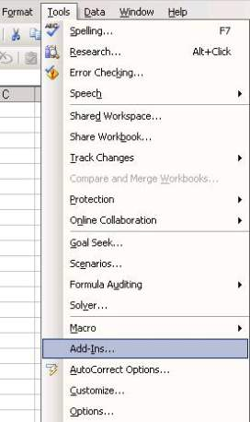
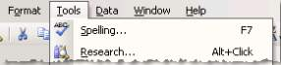
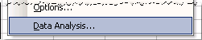
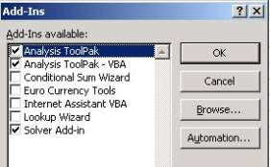
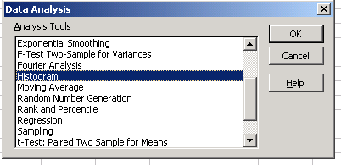
Enabling the data analysis functions in Excel (version 2007)
Use Add-ins
Enable Add-ins

Slide 14
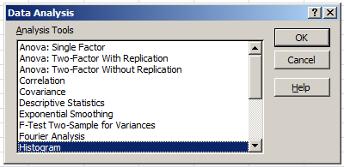
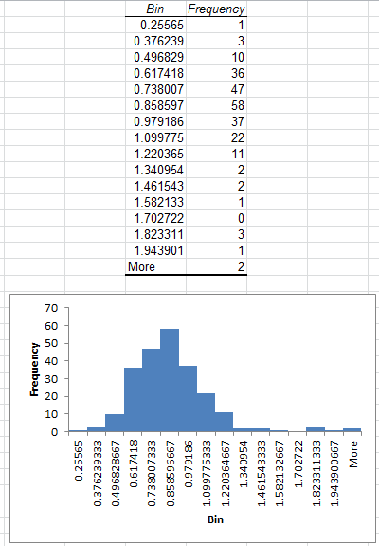
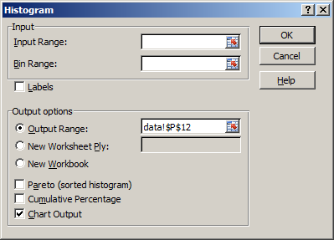
Plot the histogram in Excel

Slide 15
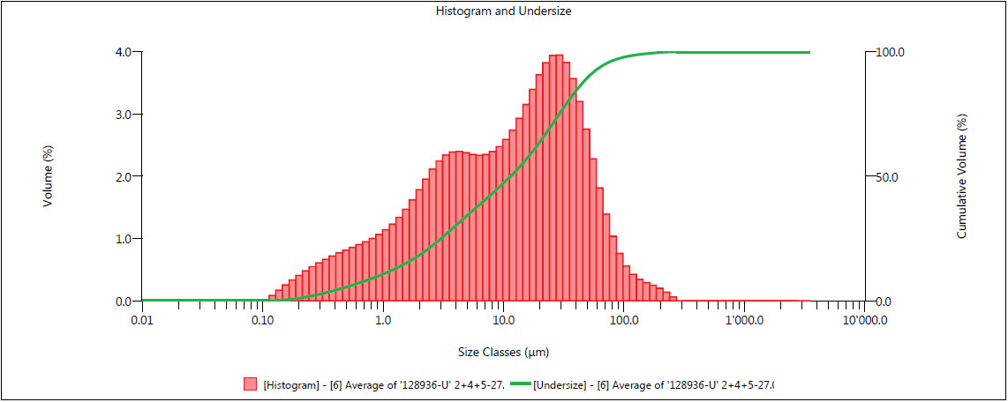
Example of a histogram: Particle size distribution
Area under the curve corresponds to probability
Density distribution q3
Density distribution Q3

Slide 16
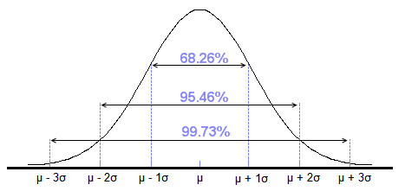
Probability distribution: Normal distribution
Areas under the normal distribution
What does this mean?
68.26% of the data lie within
95.46% of the data lie within
99.73% of the data lie within
mean
Standard dev.
±1 standard deviation
±2 standard deviation
±3 standard deviation
Notes:
Only If a parameter is normal distributed, this interpretation is allowed.
Basis for statistical process control (+- 3 sigma)
Each distribution is different (different mu, sigma), integration difficult. -> standardize normal distribution

Slide 17
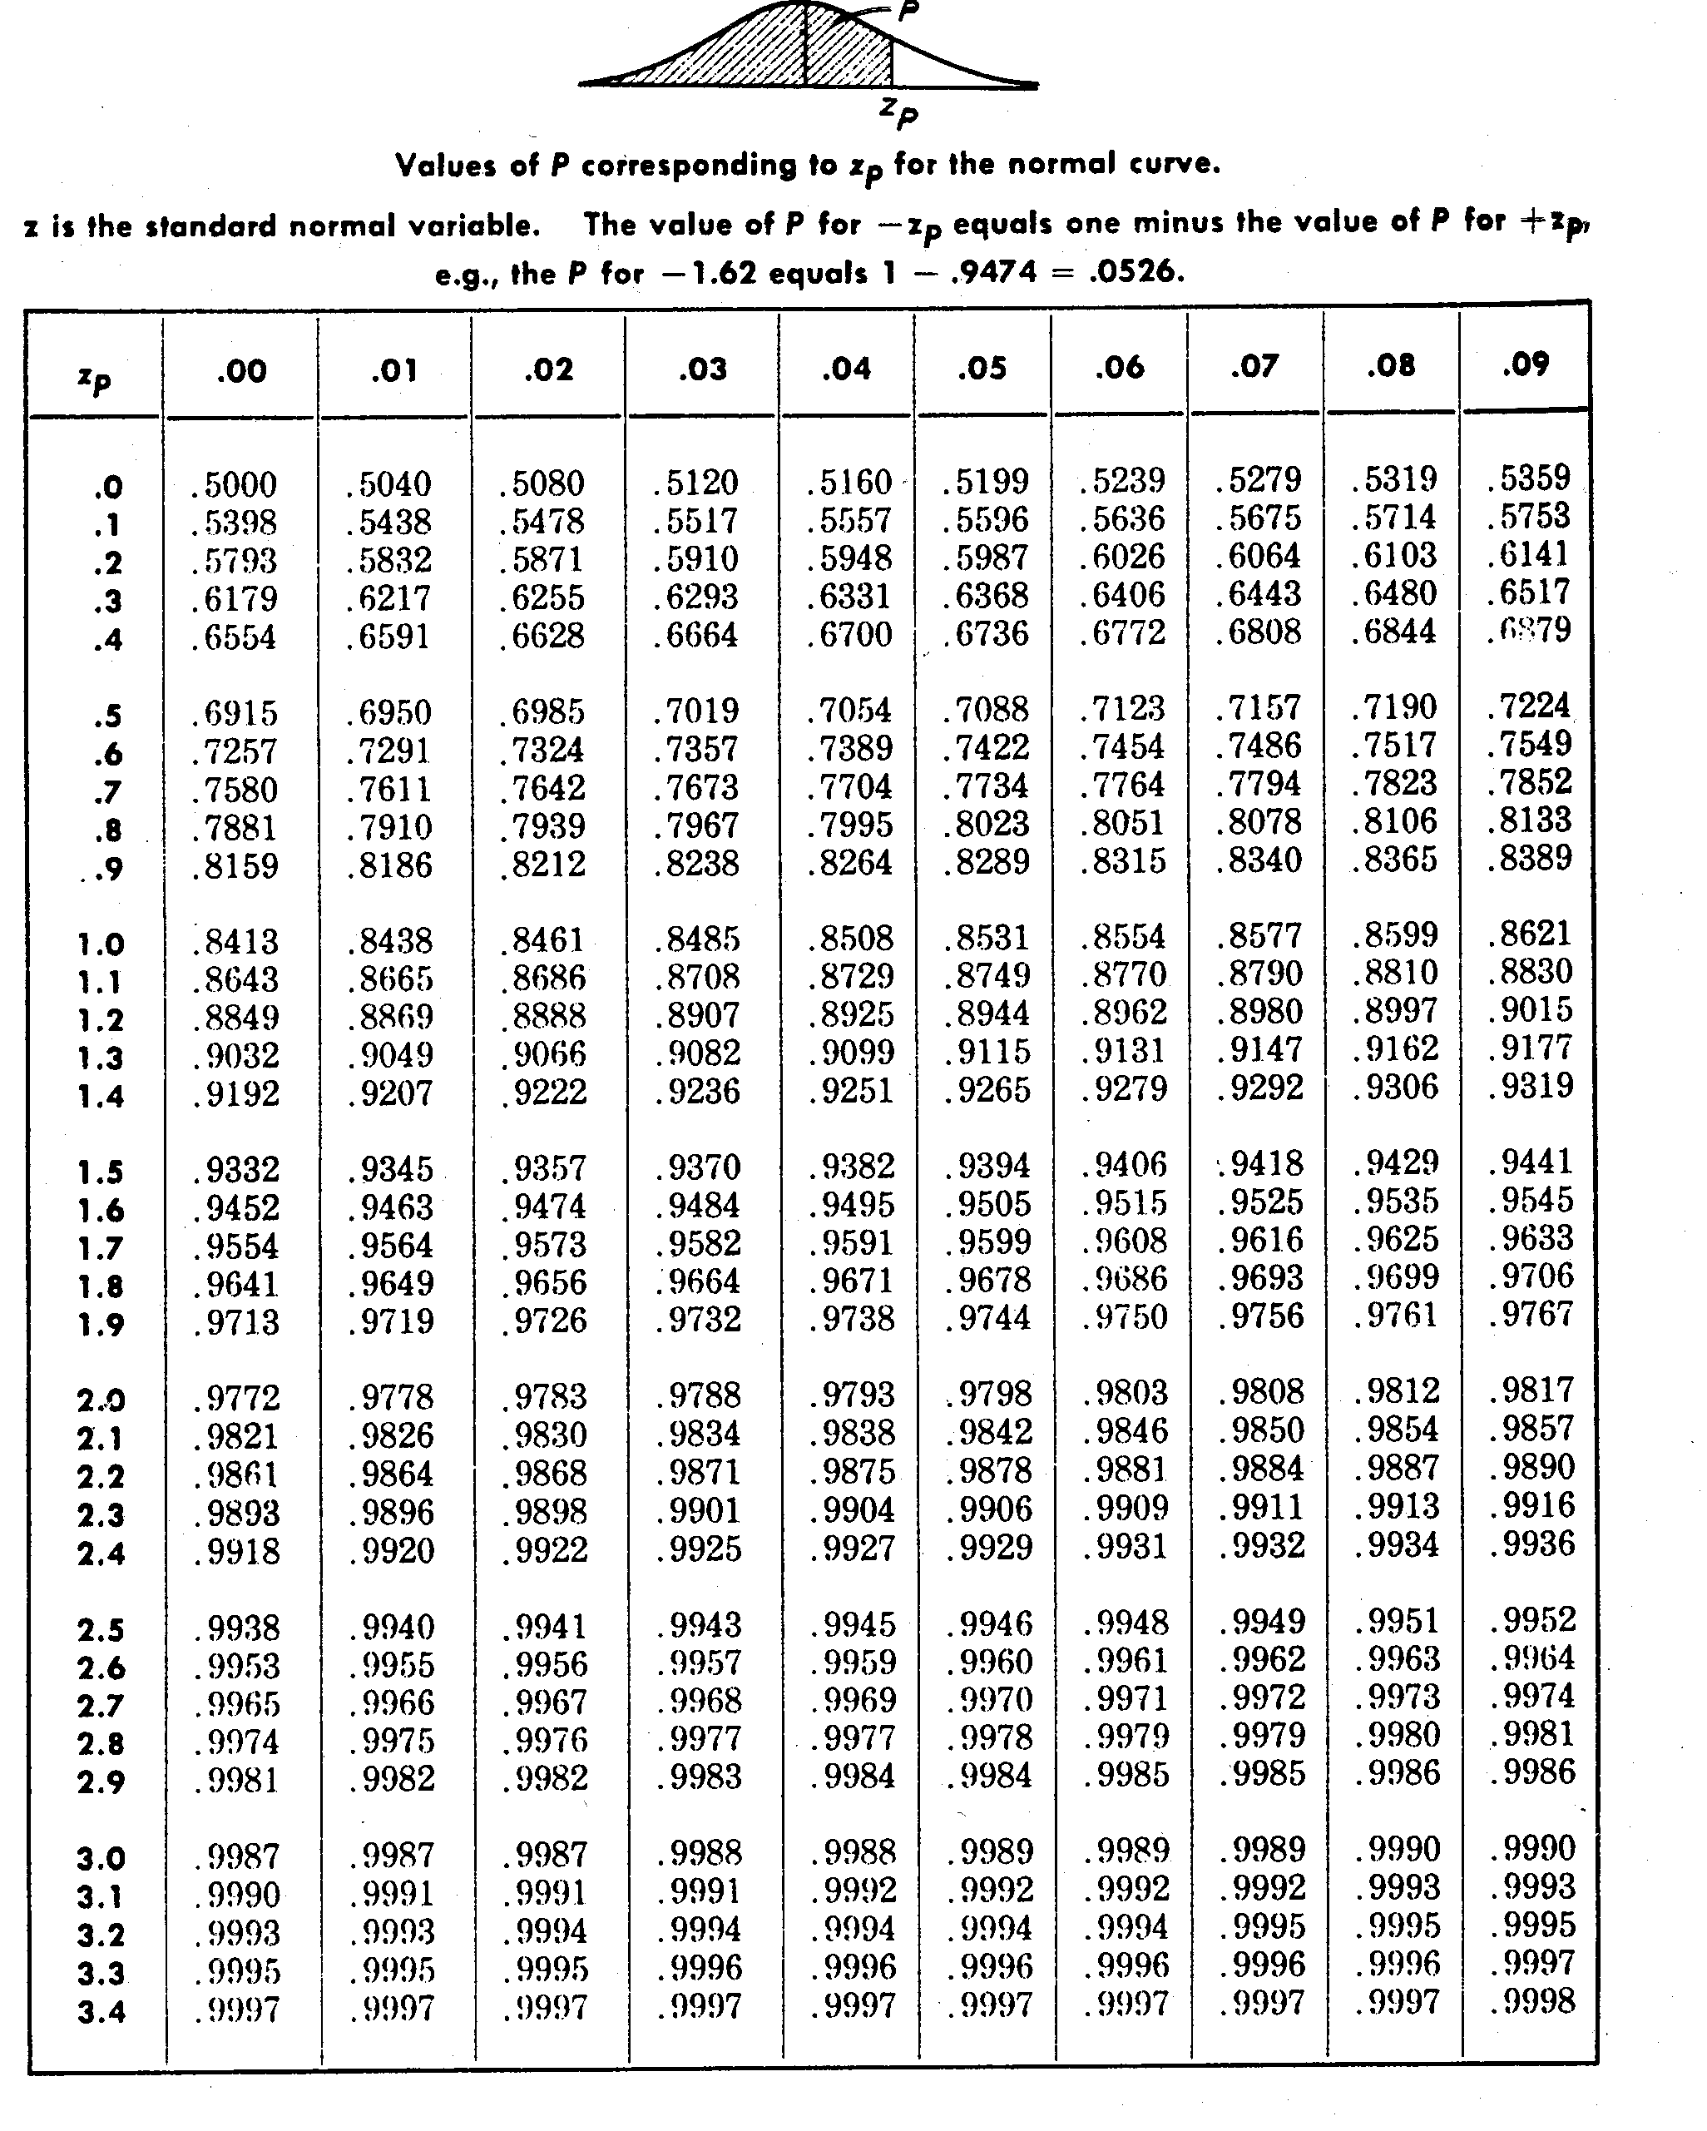
How to use the standardized normal distribution
1) Calculate the z- coordinate:
z = (x- μ)/σ
(formula just convert our normal distribution to std normal distrib.)
2) Lookup corresponding probability
Example: 28d mortar strength (normal distributed) with x = 33.2 MPa and s = 5.6.
How many samples (%) are below the minimum target of 28 Mpa?
Note: Table is in your PPE booklet

Slide 18
How many samples (%) are below the min. target of 28 Mpa?
Avg 33.2
28
MPa
27.6
x - μ
(28 - 33.2)
Z =
σ
=
= - 0.9286
5.6

Slide 19
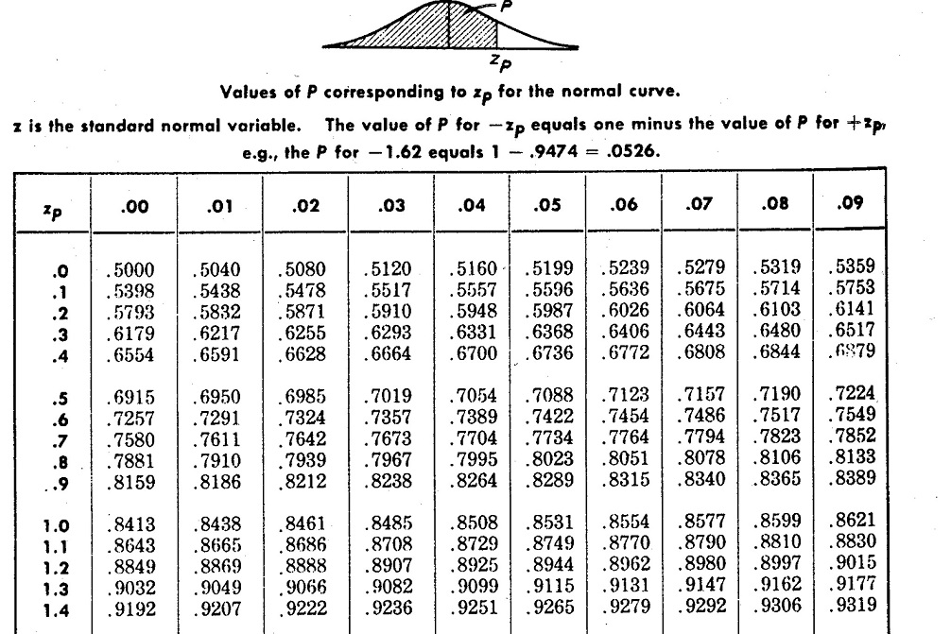
How many samples (%) are below the min. target of 28 Mpa?
Z = - 0.9286 ~ - 0.93
P(-0.93) = 1-P(0.93) = 1- 0.8238 = 0.1762
Conclusion: About 18% of my samples are below the 28 Mpa target !

Slide 20
Example continued
Same strength data (x = 33.2, s = 5.6), the minimum target is 28 MPa.
→ What should my target for the mean be, so that 95% of the samples are above 28 MPa?

Slide 21
Solution: The new average target has to be set at 37.2 MPa
Avg
37.2 MPa
x
μ
x - μ
μ = x – (s × Z)
Z =
σ
=>
=> 28.0 – (5.6x-1.64) = 37.18

Slide 22
Criteria for normal distribution
Qualitative: Histogram: symmetrical, bell-shaped
 | Definition | Example
1 | mean ≈ median | 33.2 ≈ 33.3
2 | Coefficient of variation < 30 % | 16.7 % < 30 %
3 | Kurtosis: p = 3 ± 14.7/√n | p = 2.96
4 | Skewness: p = 0 ± 7.35/ √n | p = 0.18
Notes:
Kurtosis is a descriptor of the shape of a probability distribution. Ex: A distribution with kurtosis < 3 means it produces less outliers than the normal distribution.
Skewness is a measure of the asymmetry of the probability distribution of a variable around its mean. For a unimodal distribution it does not distinguish its shape (just indicate which side is longer or fatter than the other one). In multimodal distributions, skewness is also difficult to interpret.

Slide 23
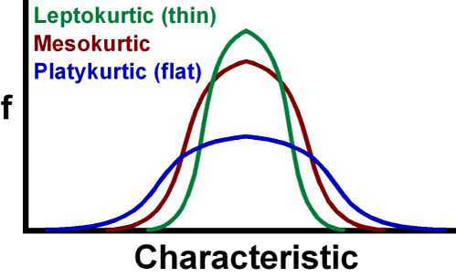
Kurtosis

Slide 24
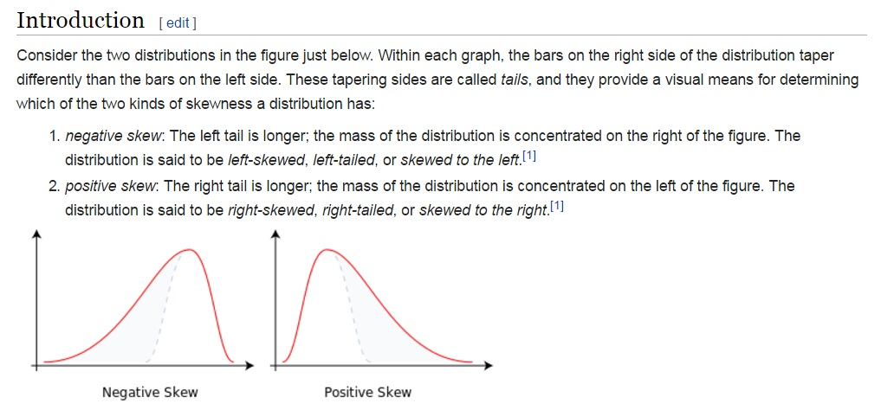
Skewness
Source: wikipedia

Slide 25
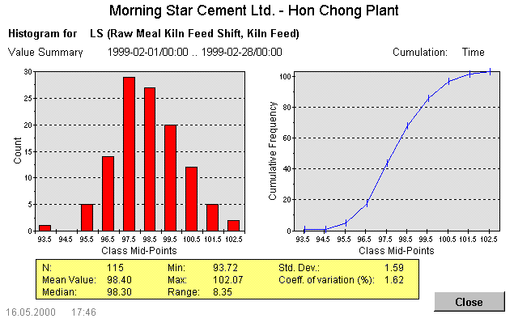
Example: Normal distribution

Slide 26
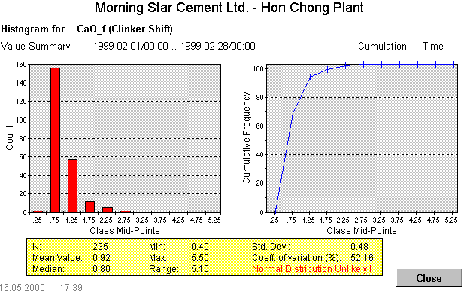
Example: Skewed distribution

Slide 27

Statistical tests – what can they do for me?
Situation: Evaluate the effect of a chemical additive on cement strength. You make a trial and test 5 samples with and without additive:
With additive: 1d strength 18.2 MPa (average)
Without additive: 1d strength 17.3 MPa (average)
Conclusion: Chemical additive enhances 1d strength.
Are you sure?
How sure?

Slide 28
Statistical tests – the procedure is always the same
State the null and the alternate hypothesis.
Calculate the tests statistics (follows a certain distribution).
Determine the reject region based on the confidence level (often designed as α)
Compare the test statistics with the reject region. If the statistics is in the reject region, reject the null hypothesis and accept the alternate hypothesis.
Very simple …. No?
Predefined by the test
Mostly 0.05 (or 95%)

Slide 29
Example: Sample representativeness
In September 2003, performance tests were conducted on the quality control equipment at the Holly Hill plant. The data shows LS readings of raw meal sampled at 2 different locations (samples were taken at 10 minute intervals).
The 1st location is the mixer outlet for the on-site XRF (AOT sample)
The 2nd location is out of the air slide on top of a silo (TOS sample).
Question: Is the AOT sample representative of the TOS sample?
The contract specified the use of a t-test to determine whether the AOT samples are representative of the TOS samples.

Slide 30
Data
How due you judge – intuitively – the difference between the LS from the two sampling locations?
Significant difference or not?

Slide 31
Step 1: Visualize data
Notes:
Do we have a paired or unpaired situation?

Slide 32
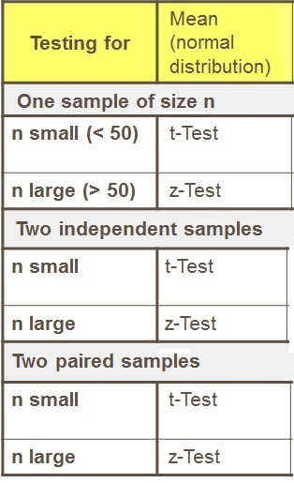
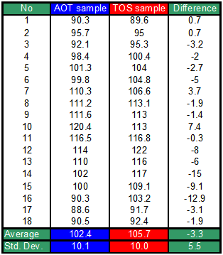
Statistical test – Paired t-test
No
No
Yes!
n<30
The paired T-test requires the difference between the two observations on each data set. (see table)

Slide 33
Paired t-test (in 5 steps)
Norm. distribution of AOT & TOS samples
Null hypothesis:
Alternate hypothesis:
Calculate the T-statistic:
μ_{AOT}
μ_{TOS}
Norm. distribution of differences
μ_{D} (-3.3)
S_{D} (5.5)
Notes:
d bar is the mean (average) of the differences
sD is the std deviantion of the differences.
n is the sample size

Slide 34
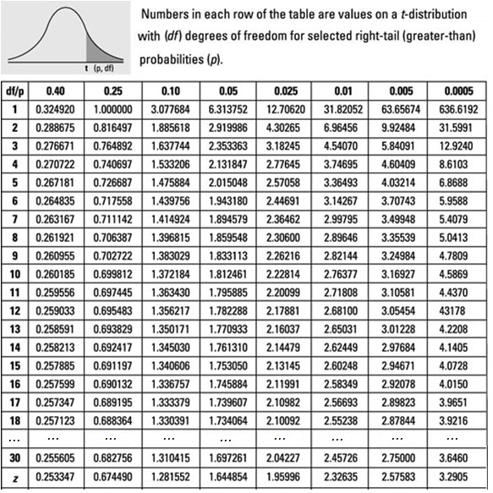
Paired t-test (in 5 steps)
4. Define the rejection region (t distribution)
and n the sample size
related to the confidence level (95%)
n-1
T-distribution table available in PPE booklet
Notes:
Alpha is the significance level: normally 0.05
Note: the higher the number of sample n, the closer the t-distribution curves would get to the z-distribution curve (or normalized distrib)

Slide 35
Paired t-test (in 5 steps)
5. Conclusion: Can we reject the null hypothesis?
→ We can reject the null hypothesis. Therefore we can conclude that the AOT sample is NOT a true representation of the TOS sample using a paired t-test.
Notes:
Alpha is the significance level: normally 0.05

Slide 36
Correlation is used to quantify the relationship between TWO or more parameters
Correlation is used for:
Optimization of Process determine influence of manipulate variable in control
Prediction of values which can not be measured directly or be measured only with long time delay (e.g. 28 days strength development)
Calibration
Root cause failure analysis analyze which parameter had a negative impact on the target value (e.g: end product quantity or quality)

Slide 37
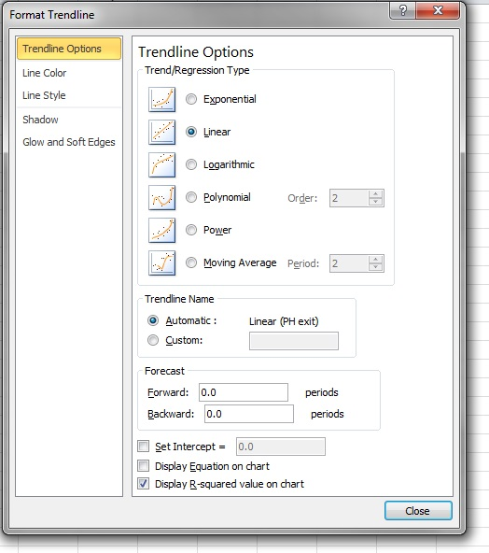
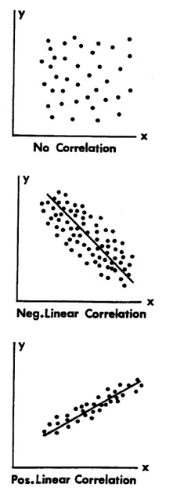
Correlation – linear correlation
Correlation determines how good the data fits to an assumed model. Measure: Correlation coefficient r (-1 < r < 1).
r ~ 0
r = -0.7
r = 0.9
Often displayed in Excel: r²
Notes:
Always plot x-y scatter diagram before assessing r_{xy}
r_{xy} is very sensitive to outliers (not robust).
A high correlation of 2 variables does not necessarily indicated causal dependence. A 3rd variable (not under control) may cause linear relationship.
To establish a causal relationship, a carefully controlled experiment must be designed.

Slide 38
Regression – linear regression
Regression: Determines the parameters of the model function to fit the observed data in a best way.
We assume the following model:
The parameters α and β are obtained by minimizing the sum of squared residuals (method of least squares):
The adequacy of the linear model can be tested with statistical tests.
The line can be used for predictions, but only within the range of the observed variables.
y_{i} the variable that we are trying to predict e_{i} Residuals; Independent normal (random) Variable.
β slope
α the y-Intercept
Notes:
Regression determines how strong is the relationship between one dependent variable and a series of other changing variables (independent variables). It is different to correlation (Correlation quantifies the degree of relationship between 2 variables. Correlation does not fit a line through the data points. We only calculate a correlation coefficient (r) that tells us how much one variable tends to change when the other one does)
There are 2 basic types of regression: linear and multiple. We here focus on linear regression.

Slide 39
Linear regression is used to mathematically define the relation between two variables
The disadvantage of any linear regression (least square) is the sensibility to unusual data-points.
But as well outliers are trying to tell us something, and we should not stop until we are comfortable in the explanation for each outlier.
Correlation does not imply causality. It is possible for two variables to be associated with each other, without one of them causing the observed behavior in the other. (third variable which is the cause?)
Testing the data for autocorrelation and underlying control algorithm is important to avoid misinterpretation
Notes:
Autocorrelation – inertia, tendency, carryover, etc. –
When it stop raining, water still pours or flows, is the accumulation NOT the rain.
Is important to identify autocorrelation.
The kiln is hot because I added fuel or because it was hot before? When did I add fuel?
residuals (observed minus mean for each data point).

Slide 40
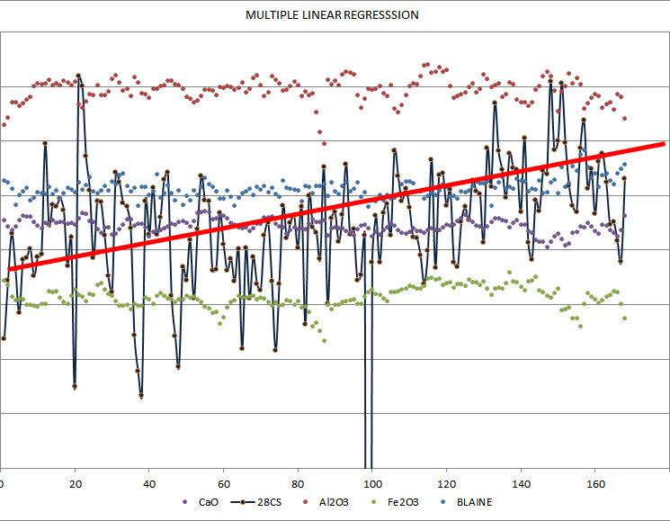
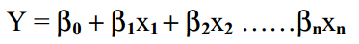
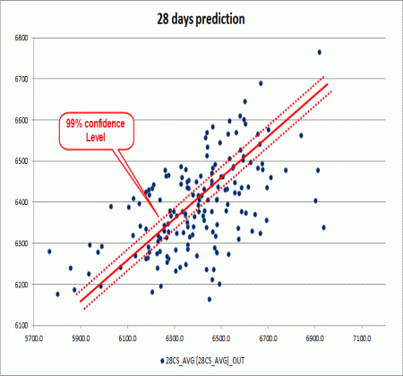
What is a multiple linear regression?
It is a statistical technique that uses several explanatory variables to predict the outcome of a response variable.
In other words we try to predict the result of one variable (Y) based on other variables (x₁,x₂…x_{n}) that affect it
Multiple linear regressions can be represented by a line which slope is defined by an equation:
β₀ is defined as the intercept, which is basically the value where the equation line crosses the “Y” axes
β_{n} are known as the coefficients, these are constant values that multiply with each of the variables (x₁,x₂…x_{n}) to approximate the regression
Depending on how exact we want our prediction to be, we define confidence levels, which indicates how much error is allowed (1,3,5,10%)

Slide 41
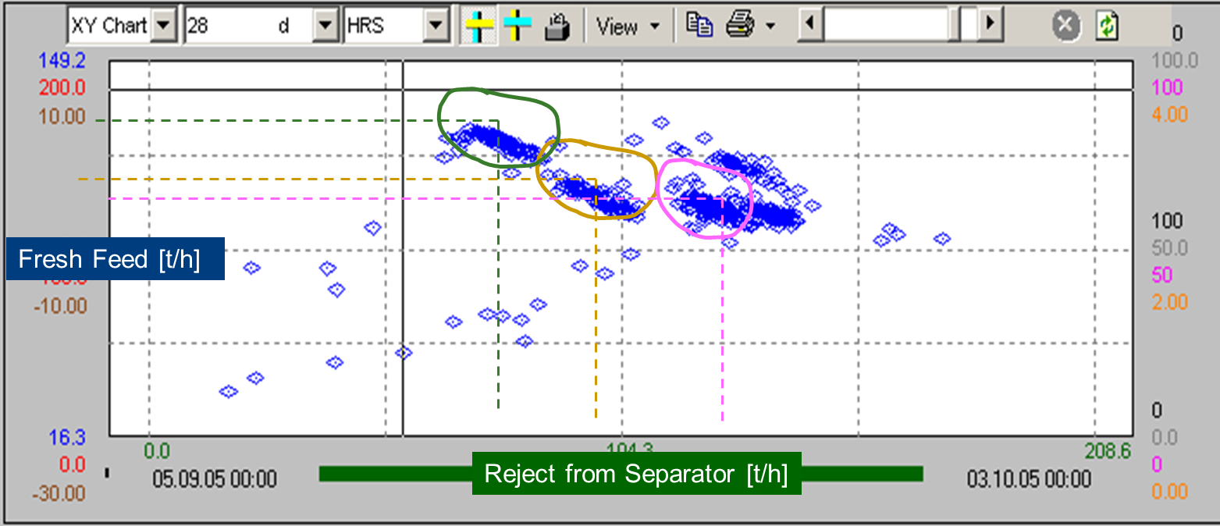
Example – Do you think there is a strong correlation?
Analysis of a Scatter Plot (X-Y Chart) showing fresh feed and reject of a mill circuit
Often displayed in Excel: r²
Notes:
The results of a correlation may be wrong or misleading, if there is an underlying control algorithm. In this case the Fresh Feed and Return are external controlled. The control loops ensures that the total feed to the mill is always according the setpoint:
Higher return results in a reduction of fresh feed.
The 4 clouds are different set points for the total feed

Slide 42
Agenda (Process Data Analysis)
Introduction
Quality Data Analysis
Basic Statistical Indicators
Normal distribution
Graphical Presentation and Analysis (control charts)
Statistical Tests
Treatment of outliers
Applications
Dixon test
Grubbs test

Slide 43
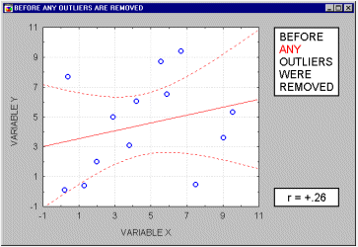
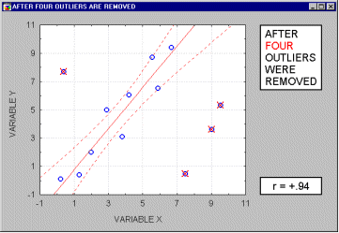
Importance of amount of data and outliers.
An outlier is an observation that is numerically distant from the rest of the data.
If the 4 outliers are removed…
Notes:
Not having enough data can mislead our results, moreover, the less data available, the more susceptible to noise it is.

Slide 44
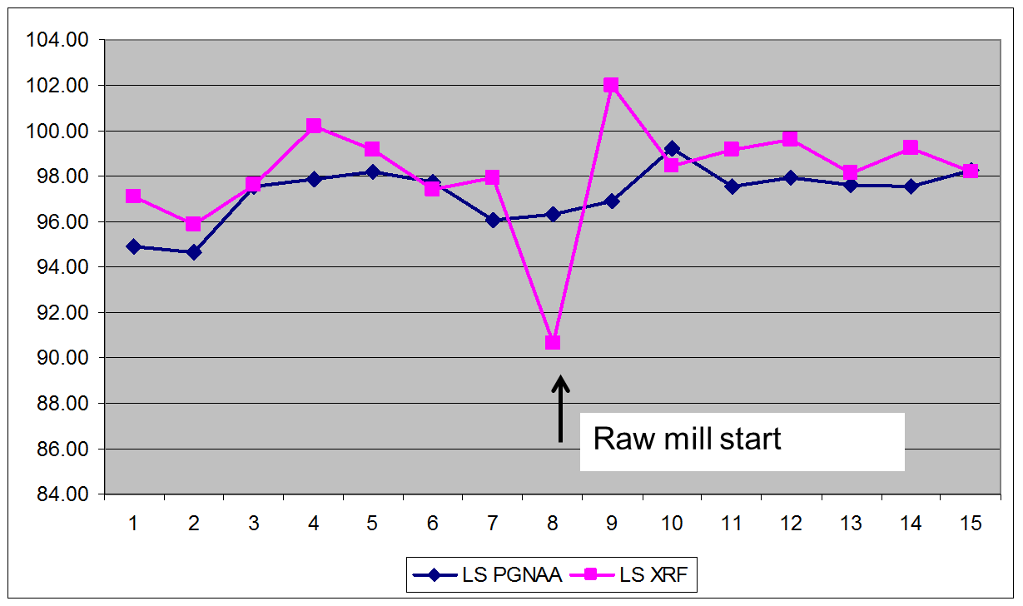
Outliers can be disturbing when calculating averages
Task: Evaluate the dynamic difference between PGNAA (raw mix) and raw meal XRF.

Slide 45
Causes of outliers in quality data
External influences (measurement error):
Malfunction of analytical equipment
Human manipulation error
Influence from environment (temperature, moisture, etc)
Errors in data transmission, typo
… etc.
Heavy tailing
For a large number of observations, a few ‘outliers’ are expected (probability distributions).

Slide 46
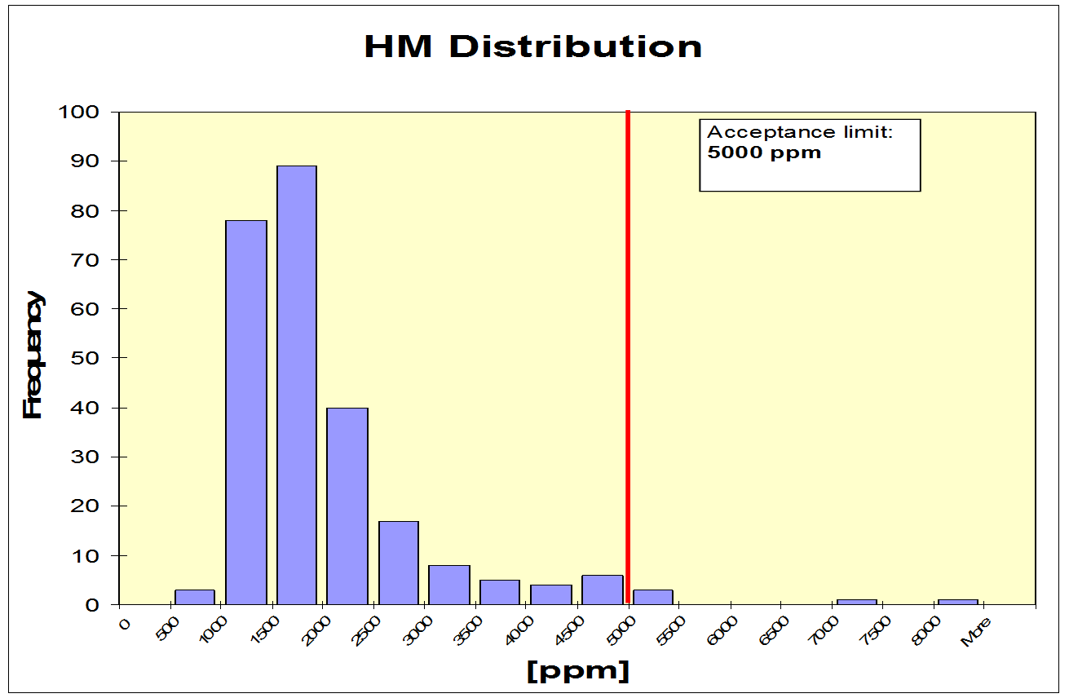
Outliers can be ‘real’ values!

Slide 47
How to identify outliers
Visualize the data (charts)
Statistical tests:
Dixon’s test (low number of observations; n < 26)
Grubb’s test (typically n > 26)
These two tests require normal distribution of the underlying population.

Slide 48
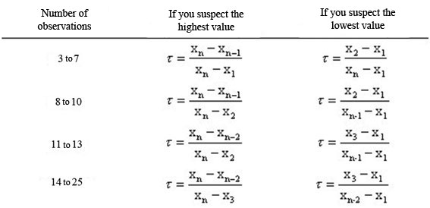
Dixon’s test (n<26)
1. Choose probability level α (that an observation is classified as outlier, even though it is not)
2. Sort the data (from lowest to highest).
3. Calculate the test statistics r_{jk}:
4. Get significance limit r_{1-α/2;n} from a table
5. If r_{jk} > r_{1-α/2;n} : Outlier.

Slide 49
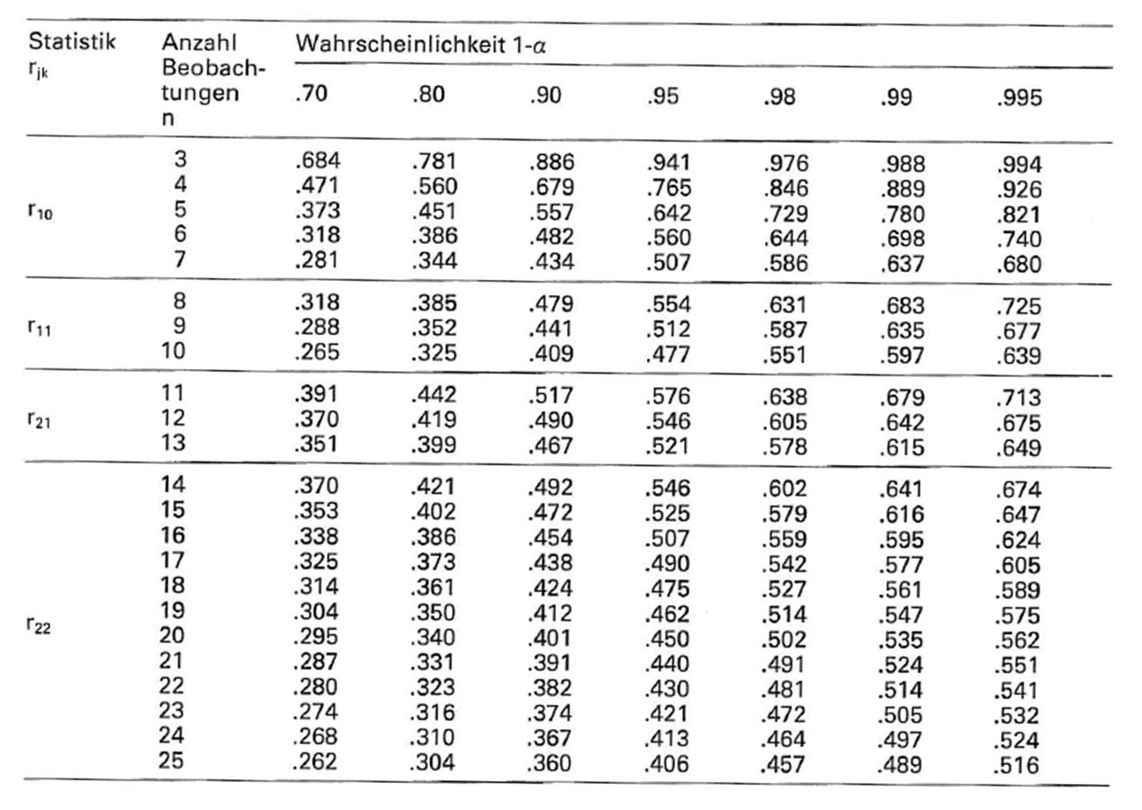
Dixon’s test: significance limits r_{jk}

Slide 50
Grubb’s Test (repetition of 4 steps)
1. Choose the probability level α.
2. Calculate the test statistics
3. Read the Critical G (according to α and n) from the table
4. Check if the selected data point is an outlier (if Gi > Critical G)
X_{i}: suspicious observation
X: Sample mean
S: Sample standard deviation

Slide 51
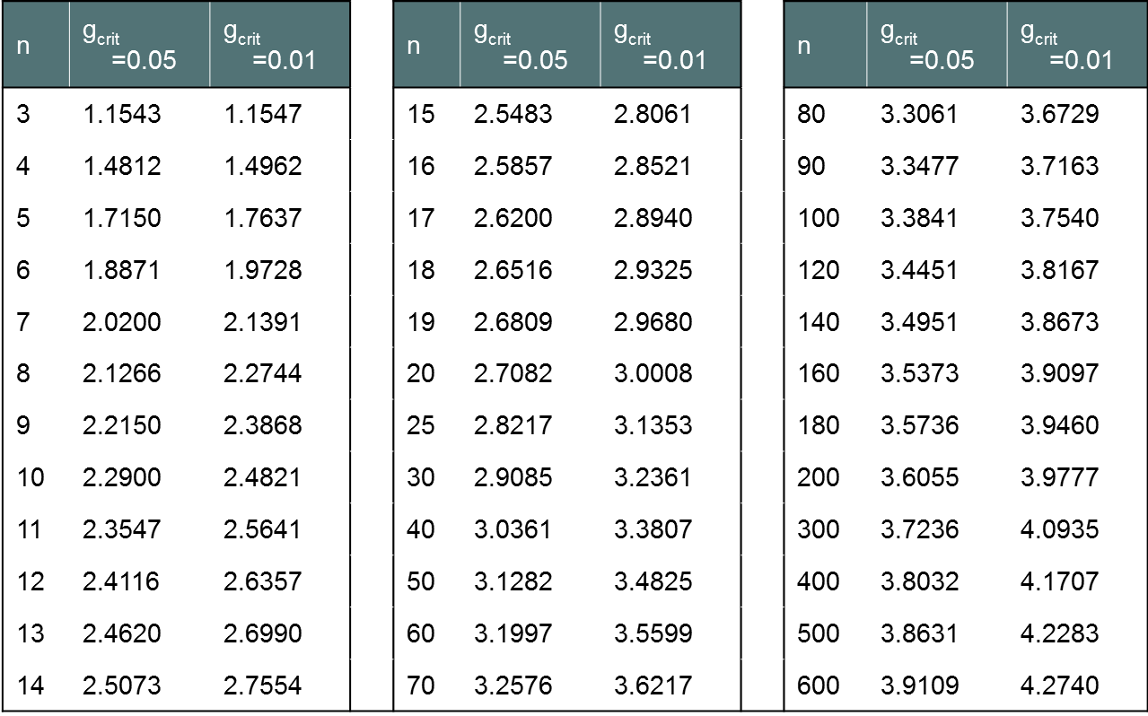
Critical G values

Slide 52
Example: SiO₂ content of low grade limestone - outliers

Slide 53
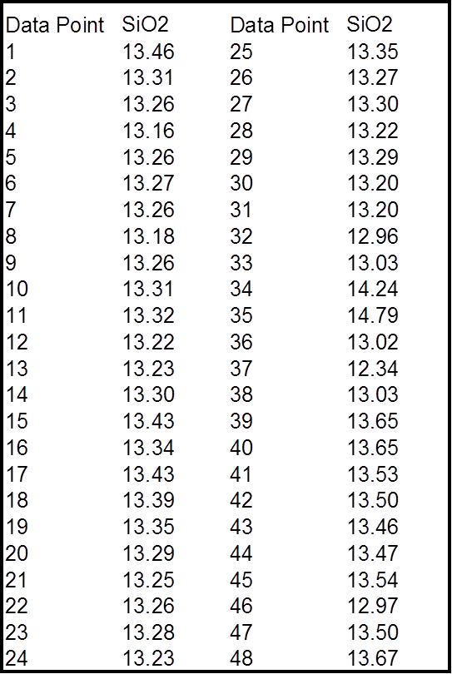
Example – Grubb’s Test
Average (X) = 13.34 %
Standard Deviation S = 0.332
Maximum = 14.79 %
Minimum = 12.34 %

Slide 54
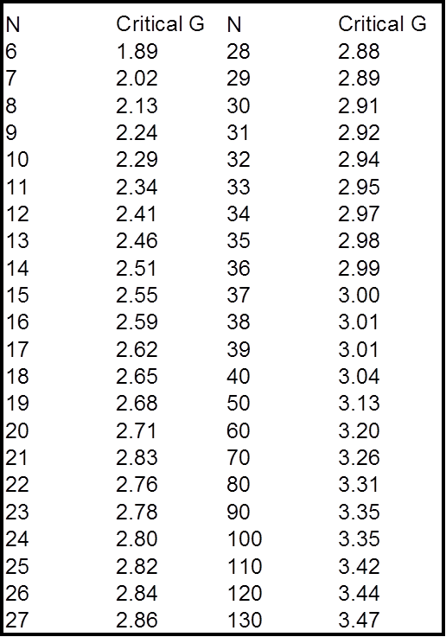
Example – Grubb’s Test
G is > Critical G:
The data point is an outlier!
Repeat the test excluding the outlier until no further outliers are present.

Slide 55
Example – Grubb’s Test - Finding Outliers
In this example there were 3 outliers.

Slide 56
Be careful with outliers
Only eliminate an observation from a dataset after one of the following
You can identify a clear cause for the outlier
You performed a statistical test
Removing data from a report should be documented!
If the cause is isolated and identified, it can lead to significant discoveries about the process and / or measurement systems under study.

Slide 57
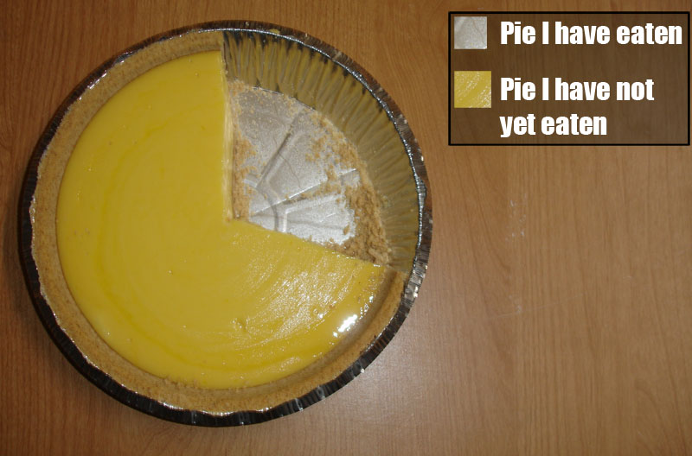
Remember: Visualize data

Slide 58
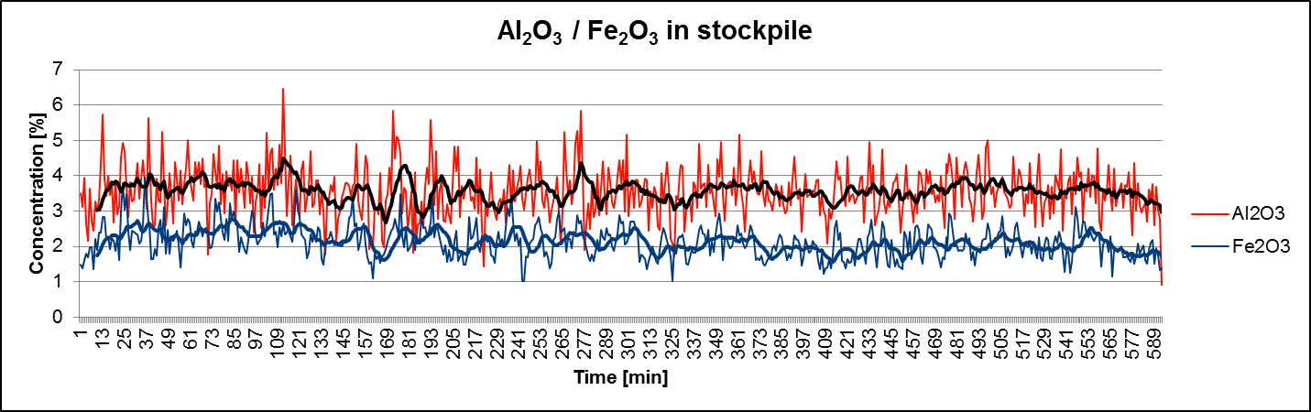
Guidelines how to make readable charts
Use label and units on the axes!
If different data series are displayed, use legends.
Use an appropriate scale
Use colors that can be distinguished
(Make use of rolling averages for time series)

Slide 59
Summary / Conclusion – What did we just learn?
What indicates central tendency: Mean and median
What indicates variability: range, standard deviation, coef. of variation
Proven good graphical tools: boxplot, histograms, x/y plot
Criteria for normal distribution (delta mean/median; CoV)
Significance of normal distribution (and its relationship with probability )
Assign a degree of confidence level to a conclusion from a dataset observation ex: independent or paired (t-test/z-test)
How good a model fits the data (correlation or regression)
Identification of outliers (Grubb/Dixon’s test)

Slide 60
THE END
Questions ?
Discussion !
Remarks ?
Objection ?

Slide 61
Annexes
What analysis should we use?

Slide 62
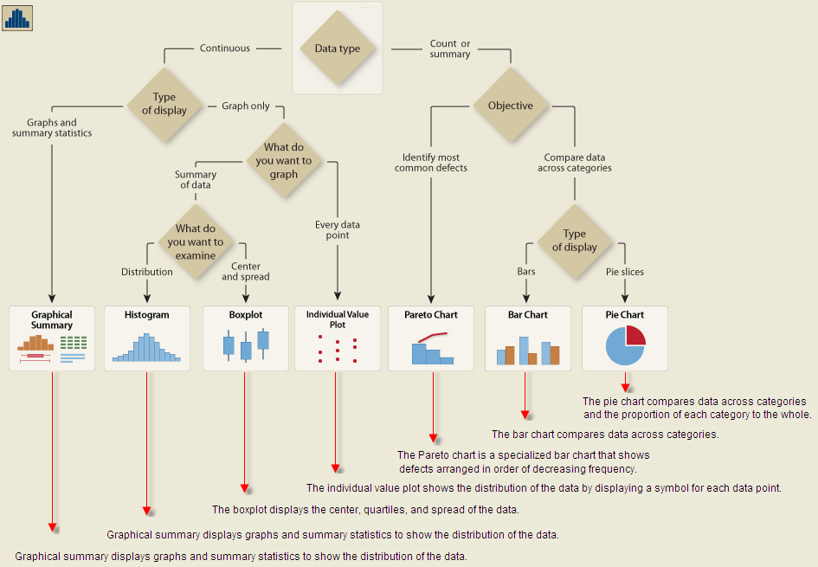
Graphical analysis. Data distribution

Slide 63
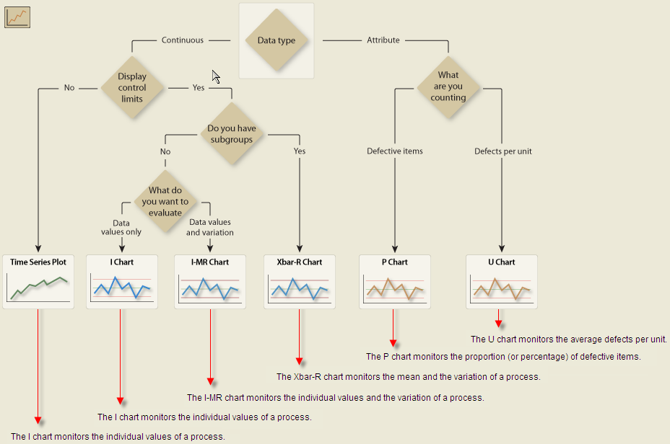
Graphical analysis: Variables over time
Notes:
Times Series Plot (process value over time)
I Chart (monitors O2)
I-MR Chart (O2 and its variation (is process in control))
XBar-R Chart (O2 average and its variation)
P Chart (how many bad clinker samples in a month)
U Chart (average of bad clinker samples per month)

Slide 64
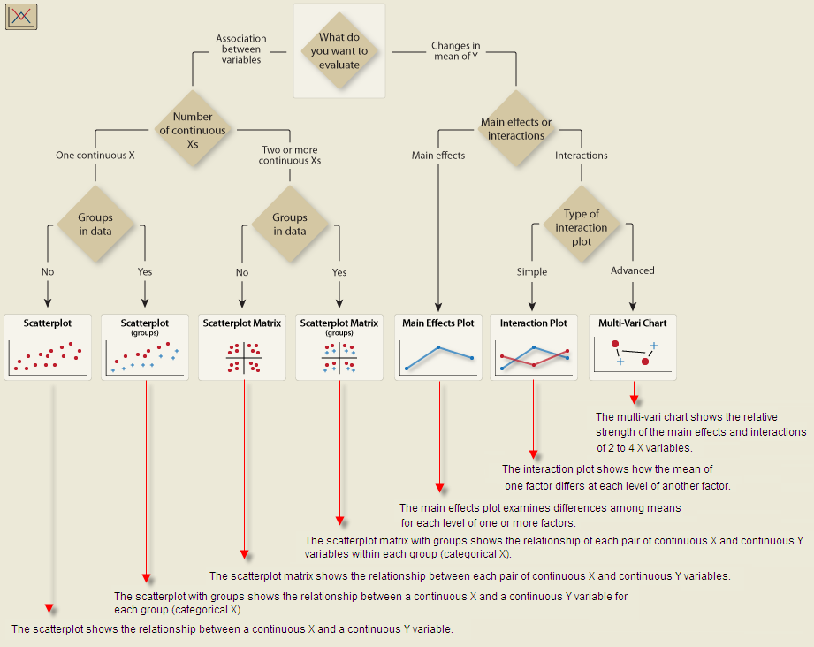
Graphical Analysis: Relationship between variables
Notes:
Scatter (o2 vs fuel)
Scatter group (o2 vs fuel)
Scatter matrix (freelime vs nox, bzt, amps)

Slide 65
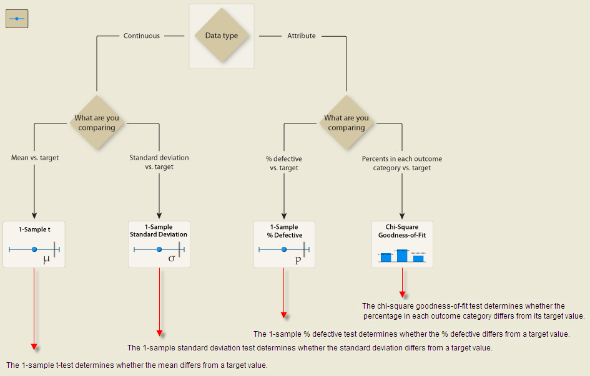
Hypothesis test: 1 variable

Slide 66
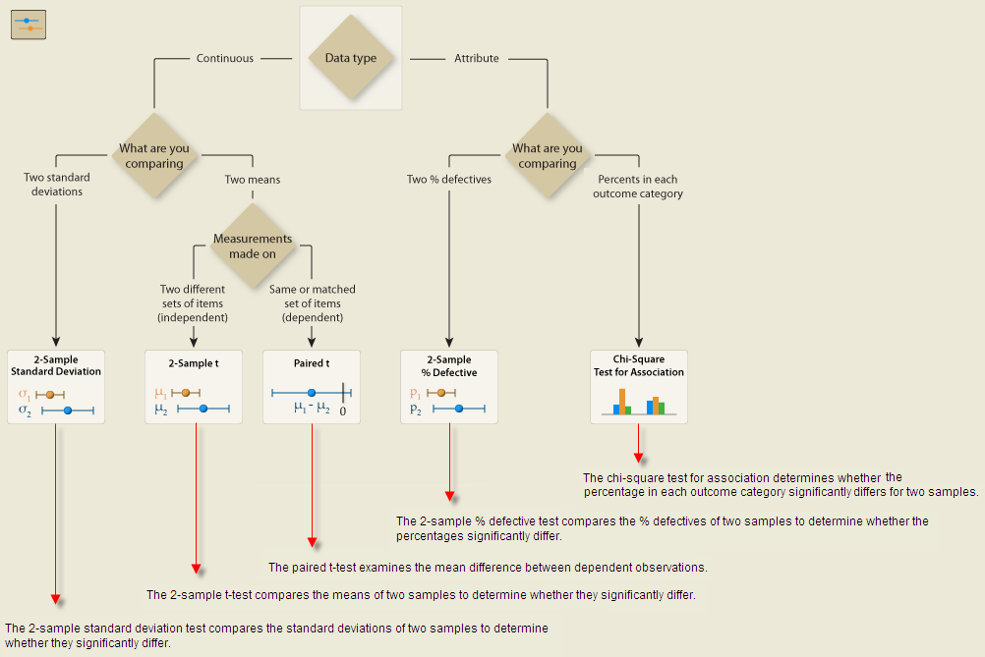
Hypothesis Test: 2 variables

Slide 67
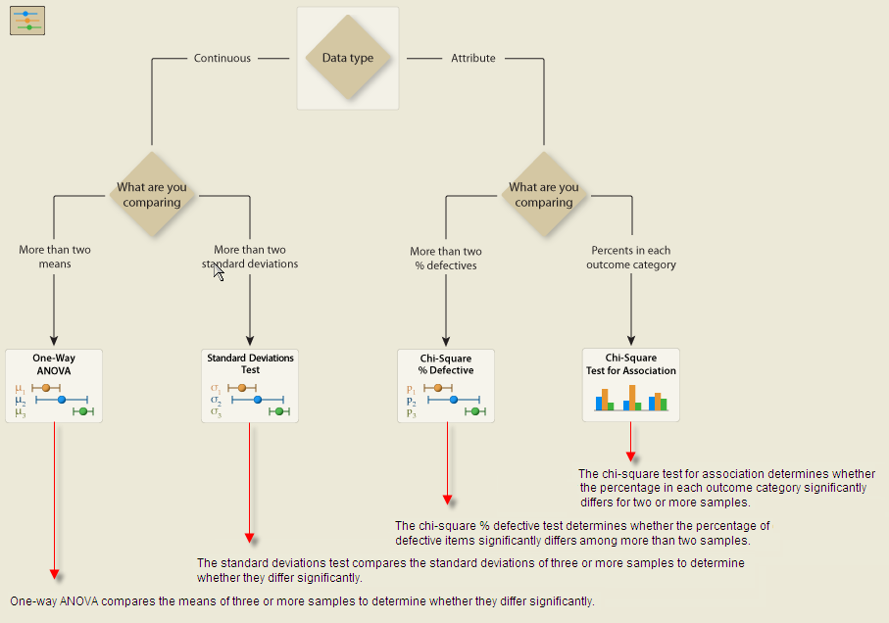
Hypothesis Test: 3 or more variables

